Slide 1
Digital data to digital signal

Slide 6
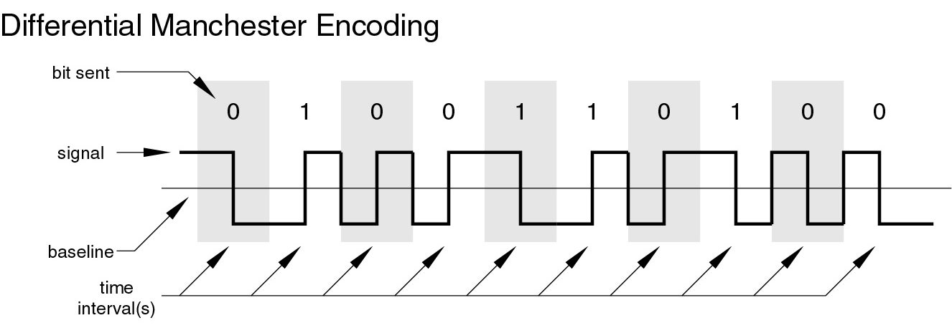
Differential Manchester Encoding

Slide 7
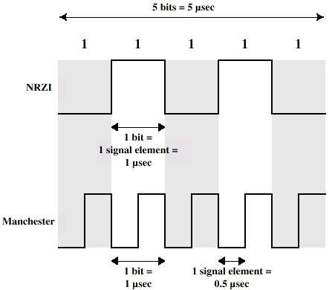
Modulation Rate

Slide 8
Modulation rate

Slide 9
Scrambling
Use scrambling to replace sequences that would produce constant voltage
Filling sequence
Must produce enough transitions to sync
Must be recognized by receiver and replace with original
Same length as original
No dc component
No long sequences of zero level line signal
No reduction in data rate
Error detection capability

Slide 10
B8ZS
Bipolar With 8 Zeros Substitution
Based on bipolar-AMI
If octet of all zeros and last voltage pulse preceding was positive encode as 000+-0-+
If octet of all zeros and last voltage pulse preceding was negative encode as 000-+0+-
Causes two violations of AMI code
Unlikely to occur as a result of noise
Receiver detects and interprets as octet of all zeros

Slide 11
HDB3
High Density Bipolar 3 Zeros
Based on bipolar-AMI
String of four zeros replaced with one or two pulses

Slide 12
HDB3 Rules

Slide 13
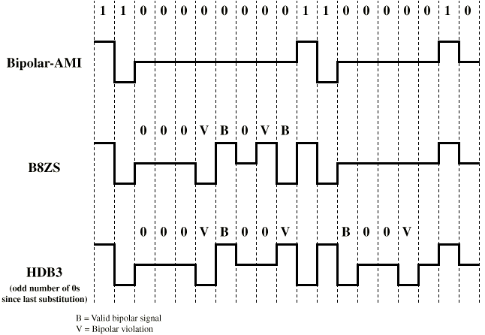
B8ZS and HDB3

Slide 15
Digital data, Analog signals

Slide 16
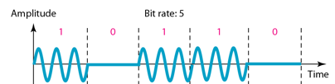
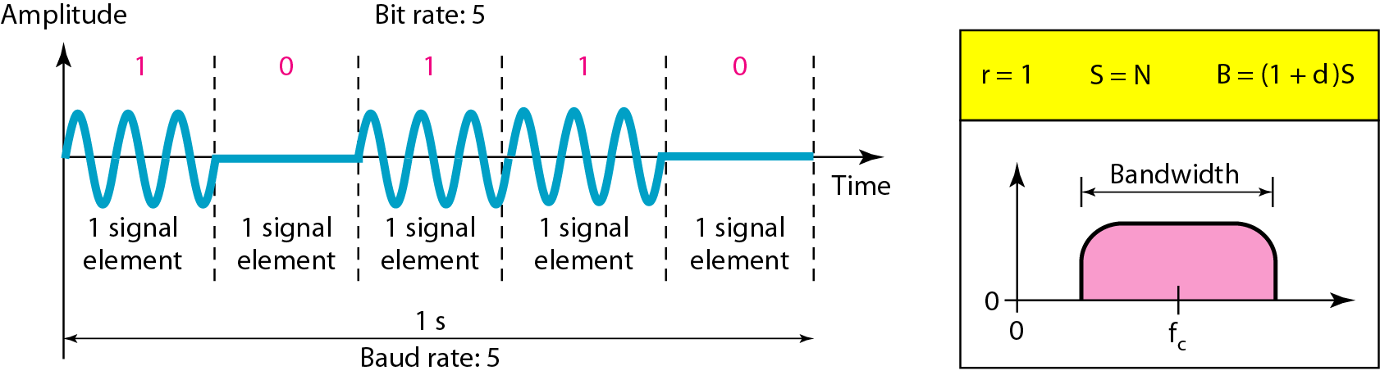
Binary amplitude shift keying

Slide 17
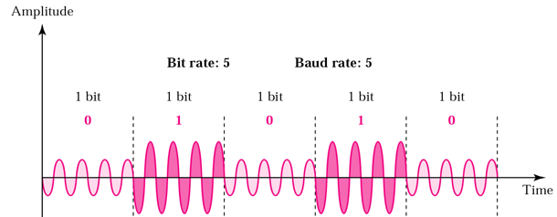
Binary amplitude shift keying

Slide 18
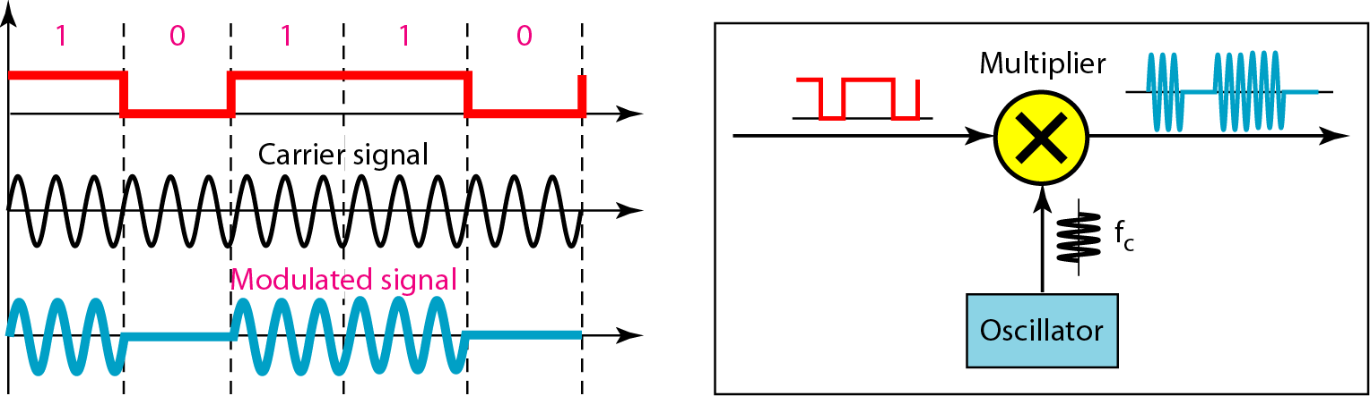
Implementation of binary ASK

Slide 19
Example
Given a bandwidth of 10,000 Hz (1000 to 11,000 Hz), draw the full-duplex ASK diagram of the system. Find the carriers and the bandwidths in each direction. Assume there is no gap between the bands in the two directions.

Slide 20
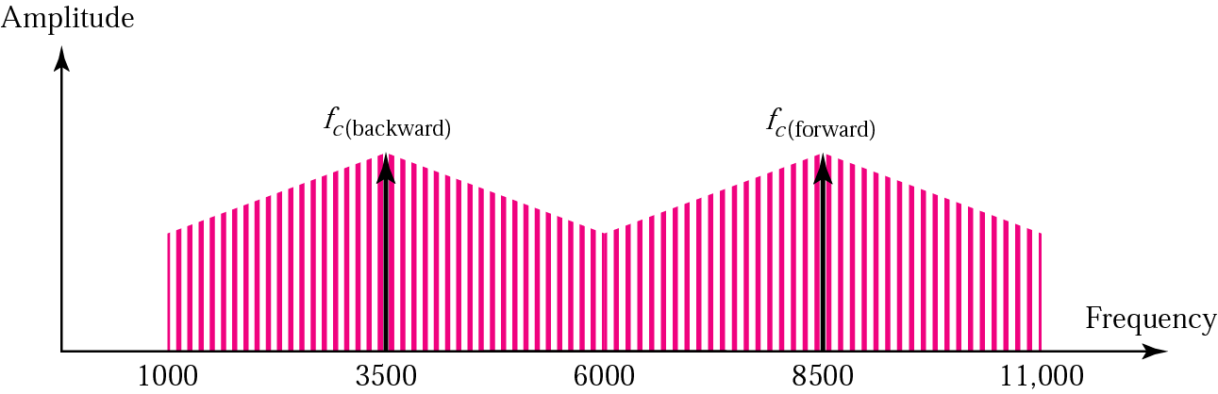
For full-duplex ASK, the bandwidth for each direction is
BW = 10000 / 2 = 5000 Hz
The carrier frequencies can be chosen at the middle of each band
fc (backward) = 1000 + 5000/2 = 3500 Hz
fc (forward) = 11000 – 5000/2 = 8500 Hz

Slide 22
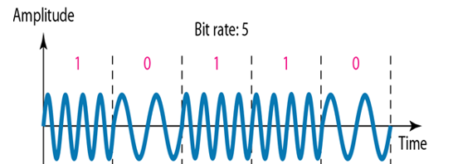
Binary frequency shift keying

Slide 23
Multiple FSK (MFSK)
More than two frequencies (M frequencies) are used
More bandwidth efficient compared to BFSK
More susceptible to noise compared to BFSK

Slide 24
MFSK signal:

Slide 27
MFSK signal:
Period of signal element
Minimum frequency separation
MFSK signal bandwidth:

Slide 28
Example
With f_{c}=250KHz, f_{d}=25KHz, and M=8 (L=3 bits), we have the following frequency assignment for each of the 8 possible 3-bit data combinations:

Slide 29
This scheme can support a data rate of:

Slide 30
Example
We need to send data 3 bits at a time at a bit rate of 3 Mbps. The carrier frequency is 10 MHz. Calculate the number of levels (different frequencies), the baud rate, and the bandwidth.

Slide 31
We can have L=3,M = 2³ = 8.
The baud rate is D=R/L
D= 3 Mbps/3 = 1 Mbaud.
The bandwidth is :
T=Bit period=1/3 micro sec
TS=LT=3*(1/3) =1 micro sec
2fd=1/TS =1MHz
Bandwidth=8MHz

Slide 32
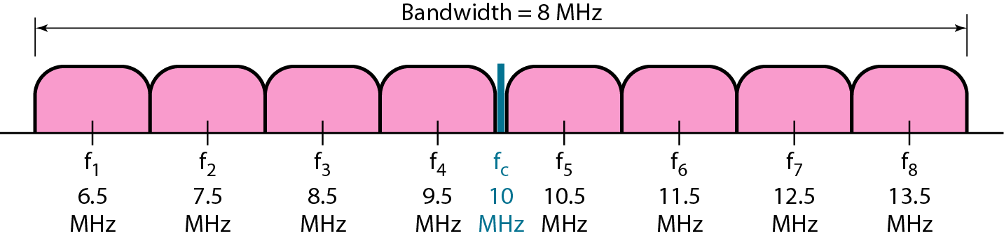

Slide 33
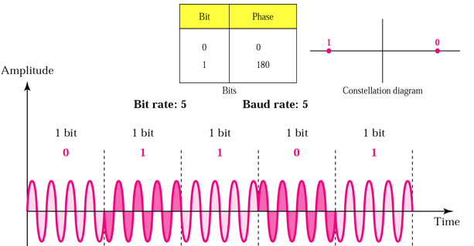
Phase Shift Keying.

Slide 34
Phase of the carrier is varied to represent digital data (binary 0 or 1)
Amplitude and frequency remains constant.
If phase 0 deg to represent 0, 180 deg to represent 1. (2-PSK)
PSK is not susceptible to noise degradation that affects ASK or bandwidth limitations of FSK

Slide 35
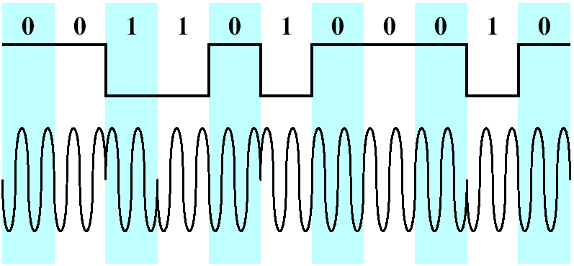
Differential PSK (DPSK)
In DPSK, the phase shift is with reference to the previous bit transmitted rather than to some constant reference signal
Binary 0:signal burst with the same phase as the previous one
Binary 1:signal burst of opposite phase to the preceding one

